Slide 1

Form Processing
Charles Severance
www.dj4e.com
https://samples.dj4e.com/getpost/
https://samples.dj4e.com/form/

Slide 2
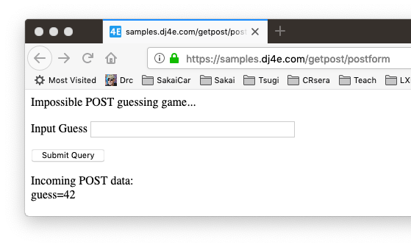
Forms gather data and send it to the server

Slide 3
Forms GET vs. POST
Two ways the browser can send parameters to the web server
GET - Parameters are placed on the URL which is retrieved.
POST - The URL is retrieved and parameters are appended to the request in the the HTTP connection.

Slide 4
Utility Code – Dump a Dictionary
# Call as dumpdata('GET', request.GET)
def dumpdata(place, data) :
retval = ""
if len(data) > 0 :
retval += '<p>Incoming '+place+' data:<br/>\n'
for key, value in data.items():
retval += html.escape(key) + '=' + html.escape(value) + '</br>\n'
retval += '</p>\n'
return retval
dj4e-samples/getpost/views.py

Slide 5
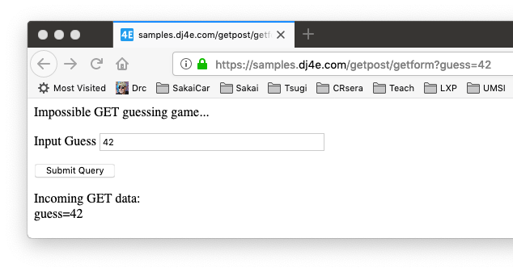
def getform(request):
response = """<p>Impossible GET guessing game...</p>
<form>
<p><label for="guess">Input Guess</label>
<input type="text" name="guess" size="40" id="guess"/></p>
<input type="submit"/>
</form>"""
response += dumpdata('GET', request.GET)
return HttpResponse(response)
dj4e-samples/getpost/views.py
https://samples.dj4e.com/getpost/getform

Slide 6

@csrf_exempt
def postform(request):
response = """<p>Impossible POST guessing game...</p>
<form method="POST">
<p><label for="guess">Input Guess</label>
<input type="text" name="guess" size="40" id="guess"/></p>
<input type="submit"/>
</form>"""
response += dumpdata('POST', request.POST)
return HttpResponse(response)
dj4e-samples/getpost/views.py
https://samples.dj4e.com/getpost/postform

Slide 7
Passing Parameters to The Server
GET /form/getform?guess=42
Accept: text/html
User-Agent: Lynx/2.4 libwww/2.14
Web Server
HTTP
Request
POST /form/postform
Accept: text/html
User-Agent: Lynx/2.4 libwww/2.14
Content-type: application/x-www-form-urlencoded
Content-length: 13
guess=42
Browser
<input type="text" name="guess" id="yourid" />

Slide 8
Rules of the POST/GET Choice
POST is used when data is being created or modified.
GET is used when your are reading or searching things.
GET should never be used to insert, modify or delete data.
Web search spiders will follow GET URLs but generally not POST URLs.
GET URLs should be “idempotent” - the same URL should give the “same thing” each time you access it.
GET has an upper limit of the number of bytes of parameters and values (think about 2K).

Slide 9
FORMS in HTML

Slide 10
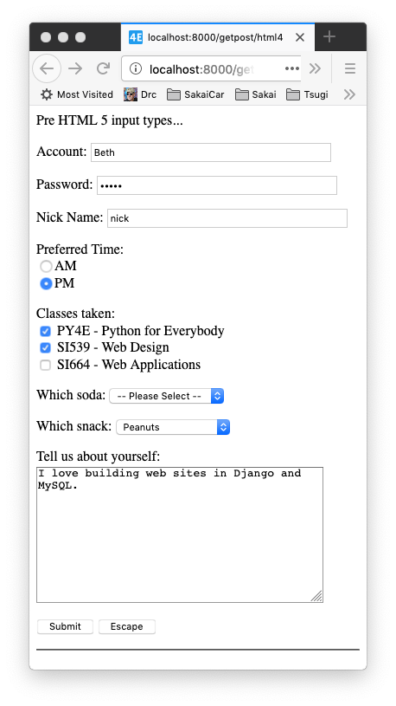
Pre HTML5 Input Types
Text
Password
Radio Button
Check Box
Select / Drop-Down
Textarea
https://samples.dj4e.com/getpost/html4
dj4e-samples/getpost/templates/getpost/html4.html

Slide 11
<p>Many field types...</p>
<form method="post">
<p><label for="inp01">Account:</label>
<input type="text" name="account" id="inp01" size="40" ></p>
<p><label for="inp02">Password:</label>
<input type="password" name="pw" id="inp02" size="40" ></p>
<p><label for="inp03">Nick Name:</label>
<input type="text" name="nick" id="inp03" size="40" ></p>
Incoming POST data: account=Beth pw=12345 nick=nick when=pm ...

Slide 12
dj4e-samples/getpost/templates/getpost/html4.html
<p>Preferred Time:<br/>
<input type="radio" name="when" value="am">AM<br>
<input type="radio" name="when" value="pm" checked>PM</p>
Incoming POST data: ... when=pm class1=on class2=si539 ...

Slide 13
<p>Classes taken:<br/>
<input type="checkbox" name="class1">
PY4E - Python for Everybody<br>
<input type="checkbox" name="class2" value="si539" checked>
SI539 - Web Design<br>
<input type="checkbox" name="class3" value="si664">
SI664 - Web Applications<br>
</p>
Incoming POST data: ... when=pm class1=on class2=si539 ...

Slide 14
<p><label for="inp06">Which soda:
<select name="soda" id="inp06">
<option value="0">-- Please Select --</option>
<option value="1">Coke</option>
<option value="2">Pepsi</option>
<option value="3">Mountain Dew</option>
<option value="4">Orange Juice</option>
<option value="5">Lemonade</option>
</select>
</p>
The values can be any string, but numbers are used quite often.
Incoming POST data: ... soda=0 snack=peanuts ...

Slide 15
<p><label for="inp07">Which snack:
<select name="snack" id="inp07">
<option value="">-- Please Select --</option>
<option value="chips">Chips</option>
<option value="peanuts" selected>Peanuts</option>
<option value="cookie">Cookie</option>
</select>
</p>
Incoming POST data: ... soda=0 snack=peanuts ...

Slide 16
dj4e-samples/getpost/templates/getpost/html4.html
<p><label for="inp08">Tell us about yourself:<br/>
<textarea rows="10" cols="40" id="inp08" name="about">
I love building web sites in Django and MySQL.
</textarea>
</p>
Incoming POST data: ... snack=peanuts about=I love building web sites in Django and MySQL. dopost=Submit

Slide 17
dj4e-samples/getpost/templates/getpost/html4.html
<input type="submit" name="dopost" value="Submit"/>
<input type="button"
onclick="location.href='http://www.dj4e.com/'; return false;"
value="Escape">
Incoming POST data: ... snack=peanuts about=I love building web sites in Django and MySQL. dopost=Submit

Slide 18
HTML5 Input Types
HTML5 defined new input types
Not all browsers support all input types
They fall back to type="text"
https://samples.dj4e.com/getpost/html5
dj4e-samples/getpost/templates/getpost/html5.html
http://www.w3schools.com/html/html5_form_input_types.asp

Slide 19
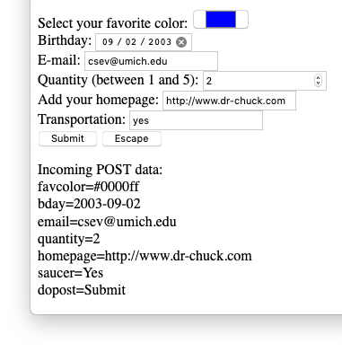
Select your favorite color:
<input type="color" name="favcolor" value="#0000ff"><br/>
Birthday:
<input type="date" name="bday" value="2003-09-02"><br/>
E-mail:
<input type="email" name="email"><br/>
Quantity (between 1 and 5):
<input type="number" name="quantity"
min="1" max="5"><br/>
Add your homepage:
<input type="url" name="homepage"><br>
Transportation:
<input type="flying" name="saucer"><br>
In-browser validation happens when you press submit.
https://samples.dj4e.com/getpost/html5

Slide 20
Cross-Site-Request-Forgery (CSRF)
Security

Slide 21
CSRF Attack
A rogue site generates a page that includes form that posts data to a legitimate site where the user is logged in via a session cookie
The form is submitted to the legitimate site and the cookie is included
The legitimate site accepts the request because of the cookie value
Note that the rogue site does not need to know the cookie value – it just knows that the cookie will be sent on requests to the legitimate site
https://en.wikipedia.org/wiki/Cross-site_request_forgery

Slide 22
CSRF Defense
The legitimate site chooses a large random number (the CSRF Token) and puts it in the session
When the legitimate site generates a POST form, it includes the CSRF Token as a hidden input field
When the form is submitted the CSRF Token is sent as well as the cookie
The site looks up the session and rejects the request if the incoming CSRF Token does not match the session's CSRF Token
https://en.wikipedia.org/wiki/Cross-site_request_forgery

Slide 23
Scenario: Time to Change a Student Grade
www.dj4e.com
Browser
Page produced by legit server.
<form method="post"
action="https://www.dj4e.com/grades/123">
<input type="text" name="new-grade"
value="0.5">
<input type="submit">
</form>
user: csev
instructor: true
42
POST /grades/123
cookie: sessid=42
new-grade=0.5
cookies
www.dj4e.com
sessid: 42
Student | Grade
123 | 0.5
456 | 1.0

Slide 24
Attack (without CSRF)
www.csrf.com
Browser
Page produced by rogue server.
<form method="post"
action="https://www.dj4e.com/grades/123">
<input type="text" name="new-grade"
value="1.0">
<input type="submit">
</form>
user: csev
instructor: true
42
www.dj4e.com
POST /grades/123
cookie: sessid=42
new-grade=1.0
cookies
www.dj4e.com
sessid: 42
Student | Grade
123 | 1.0
456 | 1.0

Slide 25
With CSRF
www.dj4e.com
Browser
Page produced by legit server.
<form method="post"
action="https://www.dj4e.com/grades/123">
<input type="hidden" name="csrf" value="99">
<input type="text" name="new-grade"
value="0.5">
<input type="submit">
</form>
user: csev
instructor: true
csrf: 99
42
POST /grades/123
cookie: sessid=42
new-grade=0.5
csrf=99
cookies
www.dj4e.com
sessid: 42
Student | Grade
123 | 0.5
456 | 1.0

Slide 26
CSRF Attack Blocked
www.csrf.com
Browser
Page produced by rogue server.
<form method="post"
action="https://www.dj4e.com/grades/123">
<input type="hidden" name="csrf" value="42">
<input type="text" name="new-grade"
value="1.0">
<input type="submit">
</form>
user: csev
instructor: true
csrf: 99
42
www.dj4e.com
POST /grades/123
cookie: sessid=42
new-grade=1.0
csrf=42
cookies
www.dj4e.com
sessid: 42
STOP
Student | Grade
123 | 0.5
456 | 1.0

Slide 27
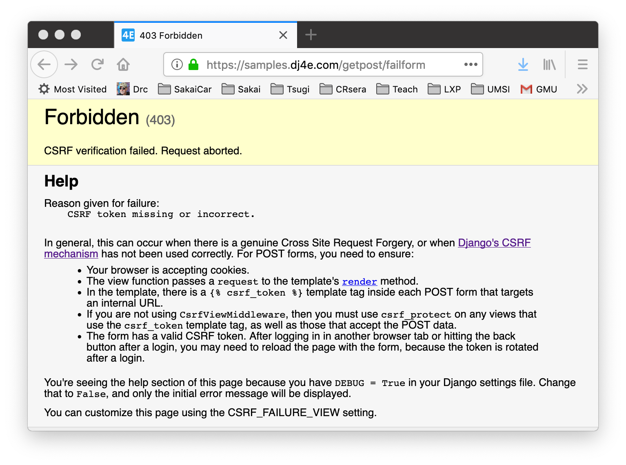
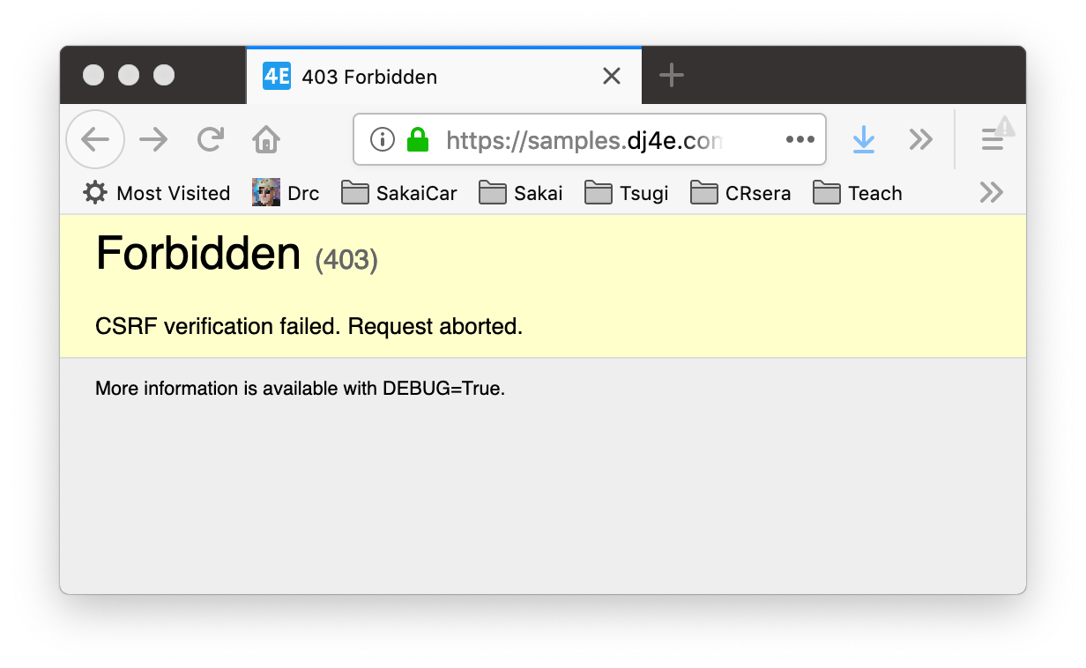

Slide 28
Enabling CSRF defense in Django
Django has built in support to generate, use, and check CSRF Tokens
Activated by default in settings.py
MIDDLEWARE = [
'django.middleware.security.SecurityMiddleware',
'django.contrib.sessions.middleware.SessionMiddleware',
'django.middleware.common.CommonMiddleware',
'django.middleware.csrf.CsrfViewMiddleware',
'django.contrib.auth.middleware.AuthenticationMiddleware',
'django.contrib.messages.middleware.MessageMiddleware',
'django.middleware.clickjacking.XFrameOptionsMiddleware',
]

Slide 29
CSRF in forms

Slide 30
Remember…..
dj4e-samples/getpost/views.py
@csrf_exempt
def postform(request):
response = """<p>Impossible POST guessing game...</p>
<form method="POST">
<p><label for="guess">Input Guess</label>
<input type="text" name="guess" size="40" id="guess"/></p>
<input type="submit"/>
</form>"""
response += dumpdata('POST', request.POST)
return HttpResponse(response)

Slide 31
https://samples.dj4e.com/getpost/failform
def failform(request):
response = """<p>CSRF Fail guessing game...</p>
<form method="post">
<p><label for="guess">Input Guess</label>
<input type="text" name="guess" size="40" id="guess"/></p>
<input type="submit"/>
</form>"""
response += dumpdata('POST', request.POST)
return HttpResponse(response)

Slide 32
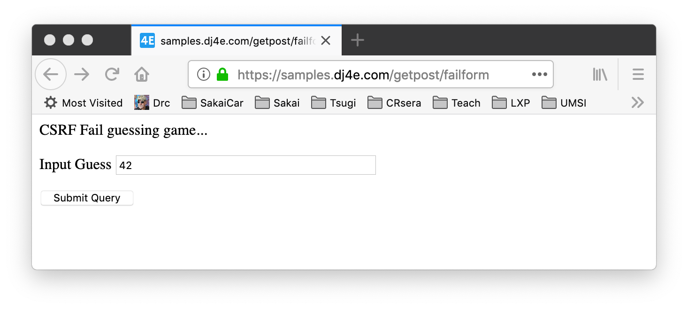
https://samples.dj4e.com/getpost/failform

Slide 34
https://samples.dj4e.com/getpost/csrfform
from django.middleware.csrf import get_token
def csrfform(request):
response = """<p>CSRF Success guessing game...</p>
<form method="POST">
<p><label for="guess">Input Guess</label>
<input type="text" name="guess" size="40" id="guess"/></p>
<input type="hidden" name="csrfmiddlewaretoken"
value="__token__"/>
<input type="submit"/>
</form>"""
token = get_token(request)
response = response.replace('__token__', html.escape(token))
response += dumpdata('POST', request.POST)
return HttpResponse(response)

Slide 35
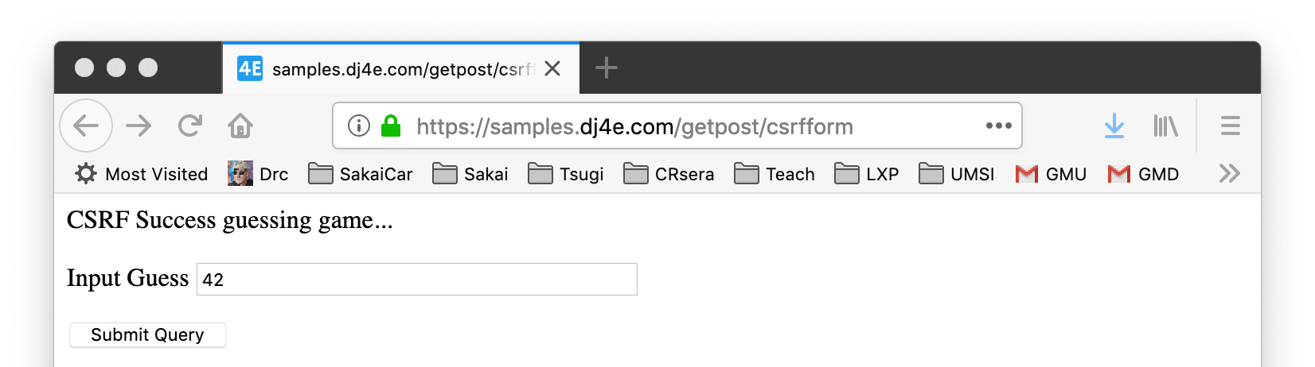
<p>CSRF Success guessing game...</p>
<form method="POST">
<p><label for="guess">Input Guess</label>
<input type="text" name="guess" size="40" id="guess"/></p>
<input type="hidden" name="csrfmiddlewaretoken"
value="fSv596BjrYhRoBkJO08jWm0h3TrTxqiIj5x32K0vXgHaHjSlX33UCJfz52b0CVa2"/>
<input type="submit"/>
</form>

Slide 36
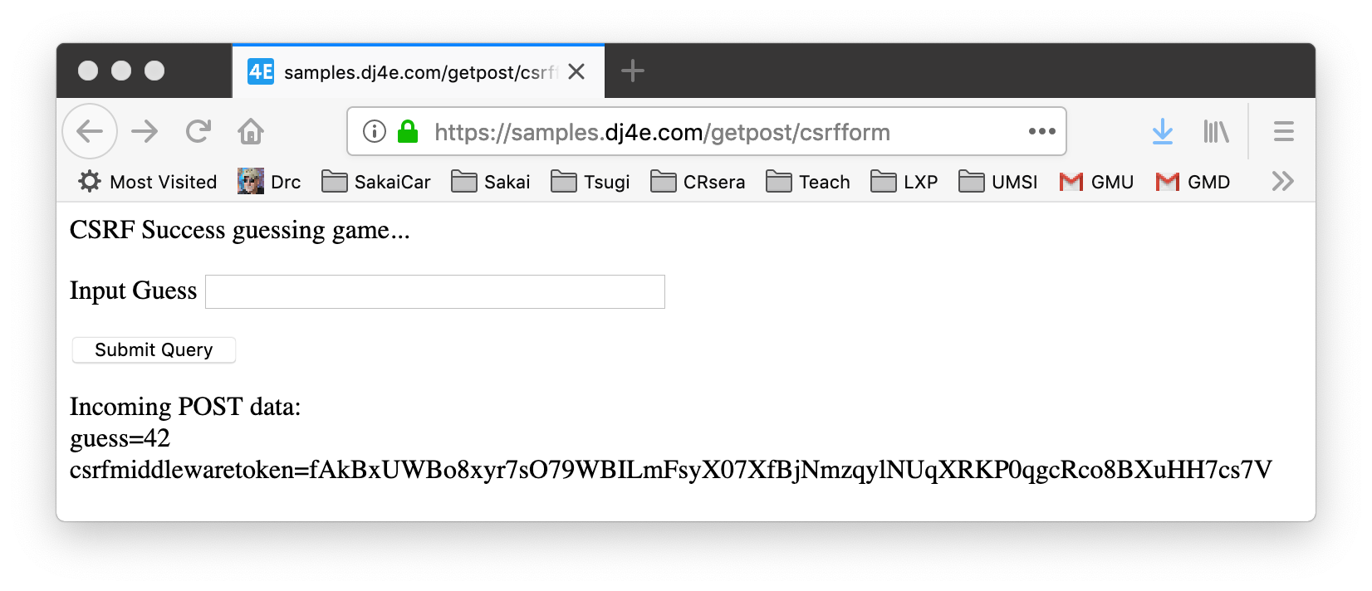

Slide 37
Django CSRF in Templates
<p>Guessing game</p>
{% if message %}
<p>{{ message }}</p>
{% endif %}
<form method="post">
<p><label for="guess">Input Guess</label>
{% csrf_token %}
<input type="text" name="guess" size="40" id="guess"/></p>
<input type="submit"/>
</form>
dj4e-samples/getpost/templates/getpost/guess.html

Slide 38
Utility Code for Guesses
dj4e-samples/getpost/views.py
# Call as checkguess('42')
def checkguess(guess) :
msg = False
if guess :
try:
if int(guess) < 42 :
msg = 'Guess too low'
elif int(guess) > 42 :
msg = 'Guess too high'
else:
msg = 'Congratulations!'
except:
msg = 'Bad format for guess:' + html.escape(guess)
return msg

Slide 39
class ClassyView(View) :
def get(self, request):
return render(request, 'getpost/guess.html')
def post(self, request):
guess = request.POST.get('guess')
msg = checkguess(guess)
return render(request, 'getpost/guess.html', {'message' : msg })
dj4e-samples/getpost/views.py
<p>Guessing game</p>
{% if message %}
<p>{{ message }}</p>
{% endif %}
<form method="post">
<p><label for="guess">Input Guess</label>
{% csrf_token %}
<input type="text" name="guess" size="40" id="guess"/></p>
<input type="submit"/>
</form>
dj4e-samples/getpost/templates/getpost/guess.html

Slide 40
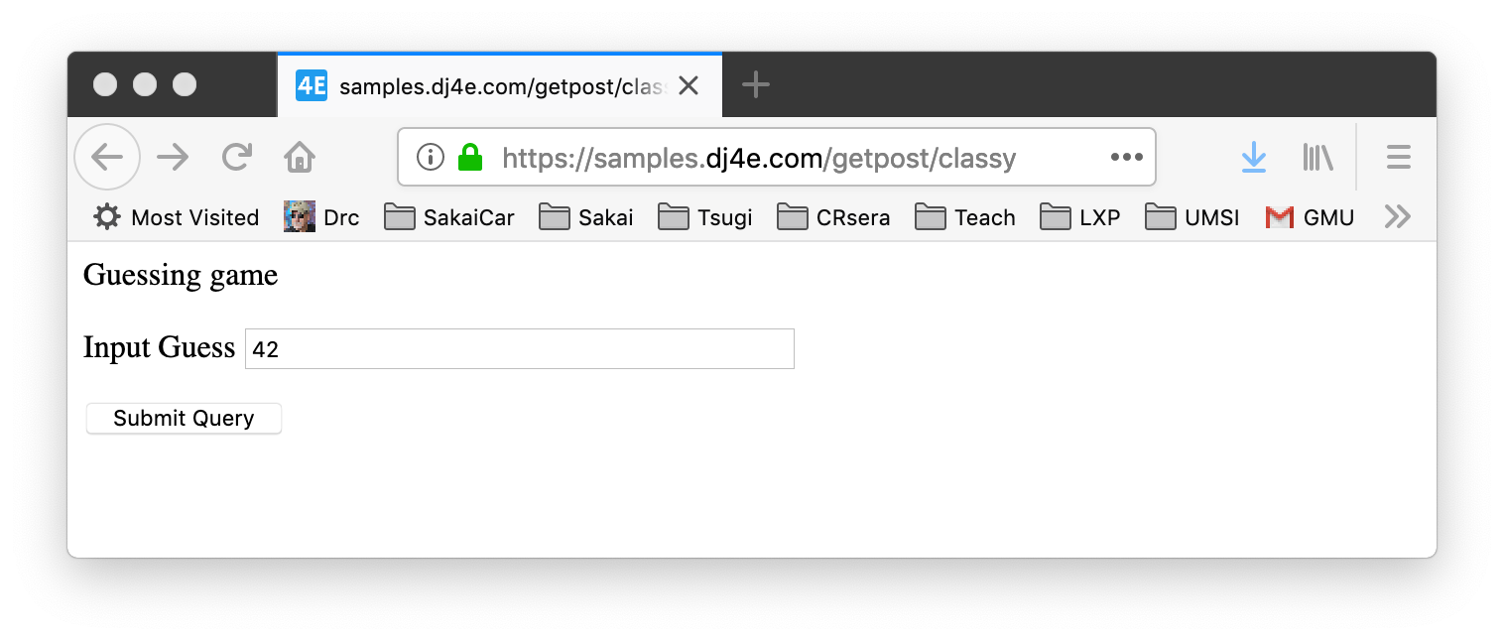
class ClassyView(View) :
def get(self, request):
return render(request, 'getpost/guess.html')
def post(self, request):
guess = request.POST.get('guess')
msg = checkguess(guess)
return render(request, 'getpost/guess.html', {'message' : msg })
dj4e-samples/getpost/views.py
https://samples.dj4e.com/getpost/classy

Slide 41
https://samples.dj4e.com/getpost/classy
<p>Guessing game</p>
<form method="post">
<p><label for="guess">Input Guess</label>
<input type="hidden" name="csrfmiddlewaretoken" value="1oV2XIi9kNx710Lcu9V4rf0TmMsAZm9w5BX0QmHlQ5XqkIjODcQF7CfboVcH4R1Q">
<input type="text" name="guess" size="40" id="guess"/></p>
<input type="submit"/>
</form>

Slide 42
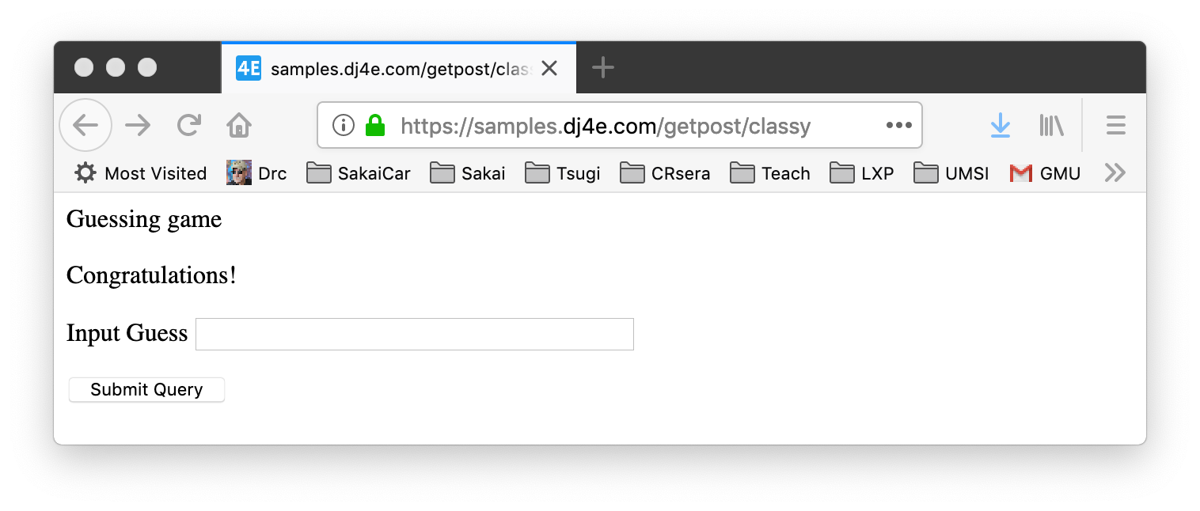
https://samples.dj4e.com/getpost/classy
Success!!!!!

Slide 43
POST-Refresh … Oops!

Slide 44
Remember this?
https://samples.dj4e.com/getpost/classy
Success!!!!!

Slide 45
POST / Refresh / ☹
Once you do a POST and receive 200 status + a page of HTML, if you tell the browser to refresh, the browser will re-send the POST data a second time.
The user gets a browser pop-up that tries to explain what is about to happen.

Slide 46
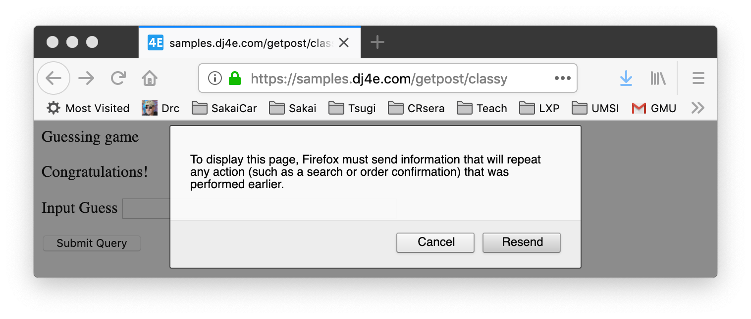
Make a POST
https://samples.dj4e.com/getpost/classy
See Success
Press Refresh
Yucky Message ☹

Slide 47
Don't Allow Double Posts
Typically POST requests are adding or modifying data whilst GET requests view data
It may be dangerous to do the same POST twice (say withdrawing funds from a bank account)
So the browser insists on asking the user (out of your control)
Kind of an ugly UX / bad usability
As developers we work so this never can happen

Slide 48
POST-REDIRECT-GET-Refresh

Slide 49
POST Redirect Rule
The simple rule for pages intended for a browser is to never generate a page with HTML content when the app receives POST data and data has been modified
Must cause a GET by redirecting somewhere - even a GET to the same URL- forcing the browser to make a GET after the POST

Slide 50
Review: HTTP Status Codes
http://www.dr-chuck.com/page1.htm - 200 OK
https://samples.dj4e.com/getpost/failform - 403 Forbidden
Post data without CSRF Token
http://www.wa4e.com/nowhere.htm - 404 Not Found
http://www.drchuck.com/ - 302 Found / Moved
Also known as “redirect”
https://en.wikipedia.org/wiki/List_of_HTTP_status_codes

Slide 51
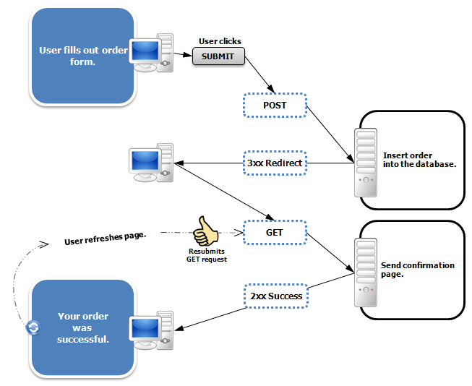
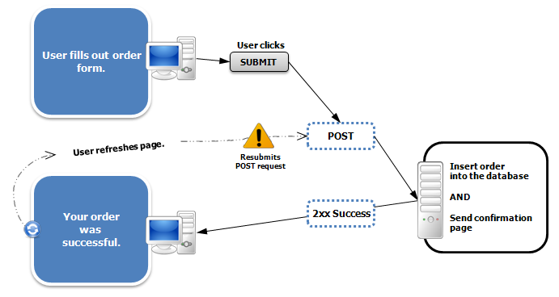
https://en.wikipedia.org/wiki/Post/Redirect/Get

Slide 52
class AwesomeView(View) :
def get(self, request):
msg = request.session.get('msg', False)
if ( msg ) : del(request.session['msg'])
return render(request, 'getpost/guess.html', {'message' : msg })
def post(self, request):
guess = request.POST.get('guess')
msg = checkguess(guess)
request.session['msg'] = msg
return redirect(request.path)
dj4e-samples/getpost/views.py
<p>Guessing game</p>
{% if message %}
<p>{{ message }}</p>
{% endif %}
<form method="post">
<p><label for="guess">Input Guess</label>
{% csrf_token %}
<input type="text" name="guess" size="40" id="guess"/></p>
<input type="submit"/>
</form>
dj4e-samples/getpost/templates/getpost/guess.html

Slide 53
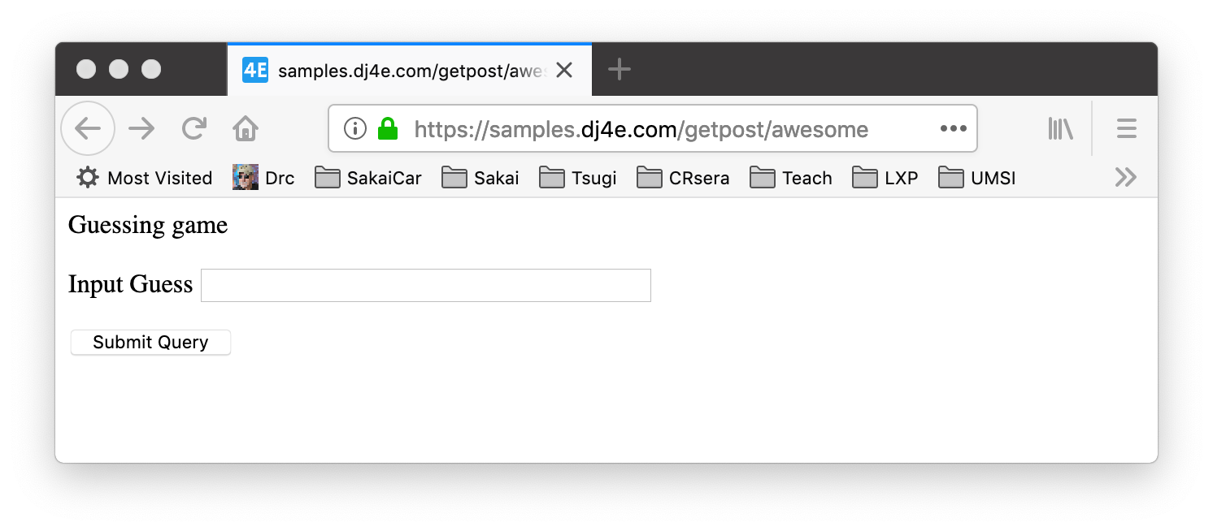
https://samples.dj4e.com/getpost/awesome
Enter guess and press Submit

Slide 54
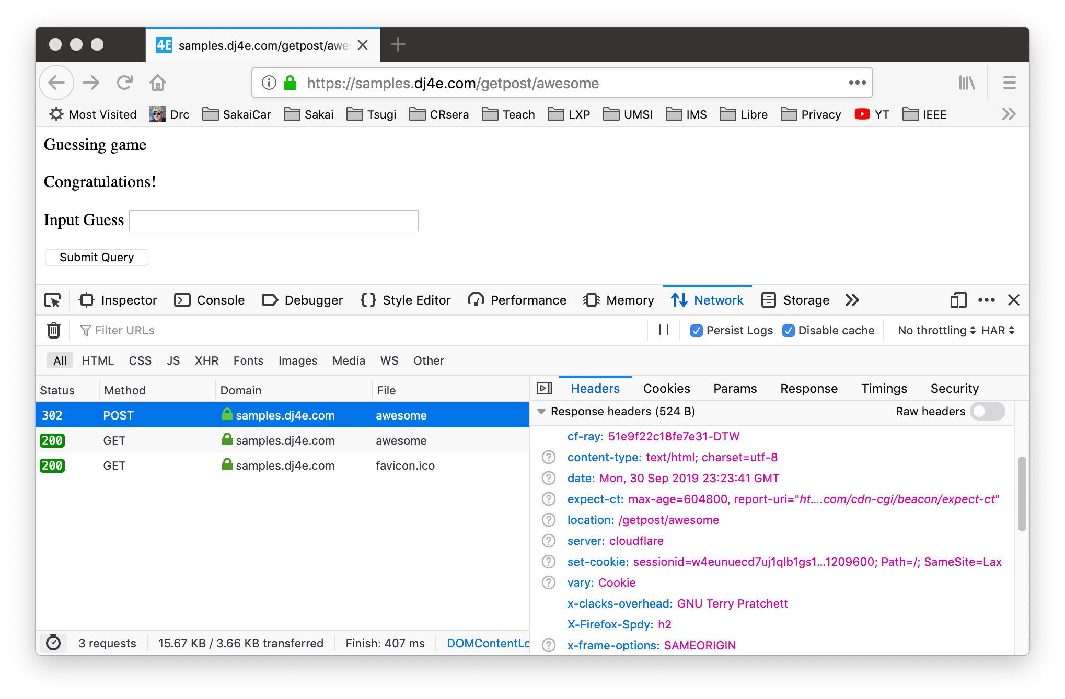
POST Response

Slide 55
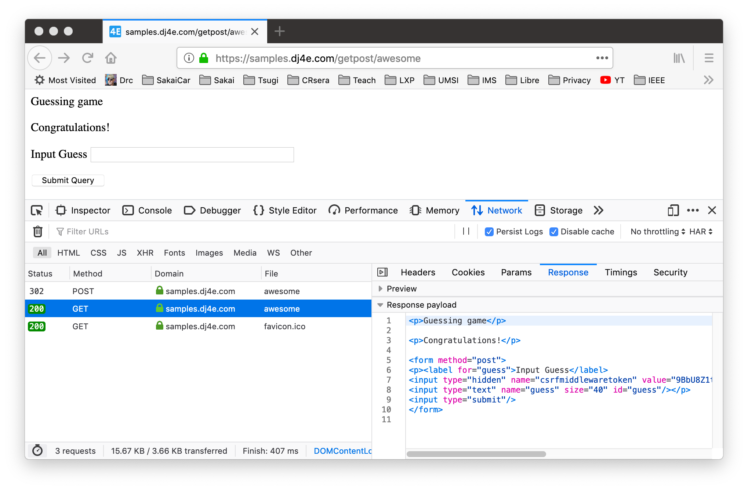
GET after Redirect

Slide 56
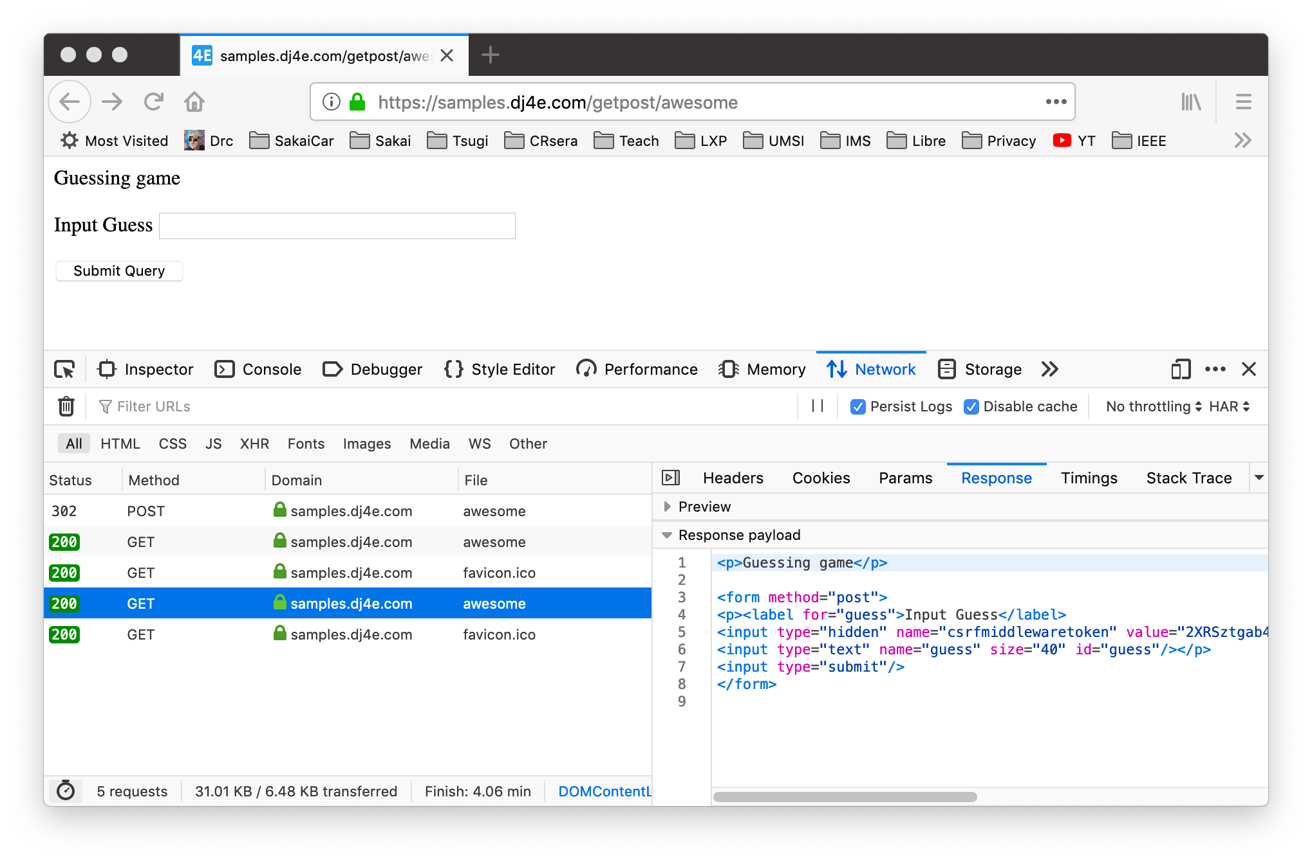
Refreshed GET

Slide 57
The response to a POST must be a redirect
Pass data to the GET – "flash message pattern"
Session can be used for flash messages
class AwesomeView(View) :
def get(self, request):
msg = request.session.get('msg', False)
if ( msg ) : del(request.session['msg'])
return render(request, 'getpost/guess.html', {'message' : msg })
def post(self, request):
guess = request.POST.get('guess')
msg = checkguess(guess)
request.session['msg'] = msg
return redirect(request.path)
dj4e-samples/getpost/views.py

Slide 58
Forms in Django
https://samples.dj4e.com/form/
https://docs.djangoproject.com/en/3.0/topics/forms/
https://github.com/csev/dj4e-samples/tree/master/form

Slide 59

Browser
Linux
D
O
M
N
G
I
N X
WGSIConfig
settings.py
Django
Routing
Click
urls.py
views.py
Parse
Response
Views
Templates
forms.py
Javascript
Database
Shell
Models
models.py
/admin
admin.py

Slide 60
Django's role in forms (DRY)
Handling forms is a complex business. Consider Django’s admin, where numerous items of data of several different types may need to be prepared for display in a form, rendered as HTML, edited using a convenient interface, returned to the server, validated and cleaned up, and then saved or passed on for further processing. Django’s form functionality can simplify and automate vast portions of this work, and can also do it more securely than most programmers would be able to do in code they wrote themselves.
Django handles three distinct parts of the work involved in forms:
preparing and restructuring data to make it ready for rendering
creating HTML forms for the data
receiving and processing submitted forms and data from the client
It is possible to write code that does all of this manually, but Django can take care of it all for you.
https://docs.djangoproject.com/en/3.0/topics/forms/#django-s-role-in-forms

Slide 61
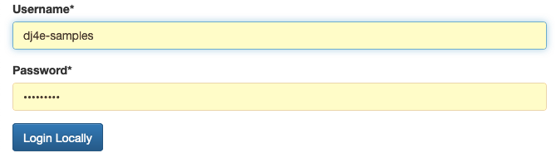
It takes a lot of CSS to make forms pretty
https://samples.dj4e.com/accounts/login/

Slide 62
Form Handling Flow is Actually Complex
Create
Produce empty form, check post data for validity, re-display form with errors if necessary, add the data to the database, and redirect the user to a success page with a success message
Update
Load old data, form with old data, check post data for validity, re-display form with errors if necessary, update the data to the database, and redirect the user to a success page with a success message
Delete
Load old data, produce confirmation page with a POST form, receive the post data, delete the record, and redirect the user to a success page with a success message

Slide 63
Create Form Flow
GET Request
Cancel
Empty Form
Enter Data
model
POST with data
Fix Data
Validate Data
Form with old data
Error?
Cancel
Store Data
Redirect to success URL
Message
GET success URL
Make Page
Success page Yay!

Slide 64
Edit Form Flow
GET Request
Load Data
Cancel
Error 404 Page
Error?
Form with old data
Edit Data
model
POST with data
Fix Data
Validate Data
Form with old data
Error?
Cancel
Load Data
Error 404 Page
Error?
Store Data
Redirect to success URL
Message
GET success URL
Make Page
Success page Yay!

Slide 65
Delete Form Flow
GET Request
Load Data
Cancel
Error 404 Page
Error?
Confirmation Form
Yes
model
POST with key
Load Data
Error 404 Page
Error?
Delete
Redirect to success URL
Message
GET success URL
Make Page
Success page Yay!

Slide 66
Django forms act as "glue"
Generate the necessary HTML to send to the browser
Allow for consistent look and feel across all the forms in an application
Receive the POST data coming back from the browser
Validate the incoming POST data and produce HTML for an error screen if necessary
Move the data from the form into a model and then store it in the database automatically
https://docs.djangoproject.com/en/3.0/topics/forms/#django-s-role-in-forms

Slide 67
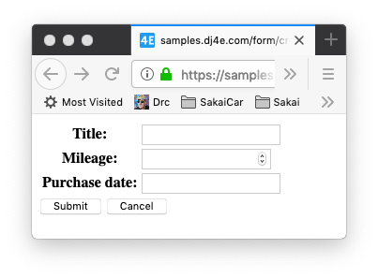
A simple form
dj4e-samples/form/forms.py
from django import forms
from django.core.exceptions import ValidationError
from django.core import validators
class BasicForm(forms.Form):
title = forms.CharField(validators=[
validators.MinLengthValidator(2, "Please enter 2 or more characters")])
mileage = forms.IntegerField()
purchase_date = forms.DateField()
https://samples.dj4e.com/form/create

Slide 68
Dumping a form object
https://samples.dj4e.com/form/example
dj4e-samples/form/forms.py
<tr><th>
<label for="id_title">Title:</label></th>
<td><input type="text" name="title"
required id="id_title"></td></tr>
<tr><th>
<label for="id_mileage">Mileage:</label>
</th><td>
<input type="number" name="mileage" required id="id_mileage">
</td></tr>
<tr><th>
<label for="id_purchase_date">
Purchase date:</label>
</th><td>
<input type="text" name="purchase_date"
required id="id_purchase_date">
</td></tr>
class BasicForm(forms.Form):
title = forms.CharField(validators=[
validators.MinLengthValidator(2, "...")])
mileage = forms.IntegerField()
purchase_date = forms.DateField()
dj4e-samples/form/views.py
from form.forms import BasicForm
def example(request) :
form = BasicForm()
return HttpResponse(form.as_table())

Slide 69
A form in a template
dj4e-samples/form/templates/form/form.html
<p>
<form action="" method="post">
{% csrf_token %}
<table>
{{ form.as_table }}
</table>
<input type="submit" value="Submit">
<input type="submit"
onclick="window.location='{% url 'form:main' %}' ; return false;"
value="Cancel">
</form>
</p>

Slide 70
A form in a template
https://samples.dj4e.com/form/create
dj4e-samples/form/views.py
class SimpleCreate(DumpPostView):
def get(self, request) :
form = BasicForm()
ctx = {'form' : form}
return render(request, 'form/form.html', ctx)

Slide 71
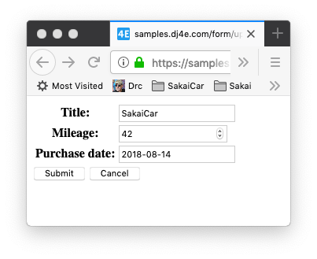
Pulling existing data into a form
https://samples.dj4e.com/form/update
dj4e-samples/form/views.py
class SimpleUpdate(DumpPostView):
def get(self, request) :
old_data = {
'title': 'SakaiCar',
'mileage' : 42,
'purchase_date': '2018-08-14'
}
form = BasicForm(old_data)
ctx = {'form' : form}
return render(request, 'form/form.html', ctx)

Slide 72
Data Validation in FORMS

Slide 73
Create Form Flow
GET Request
Cancel
Empty Form
Enter Data
model
POST with data
Fix Data
Validate Data
Form with old data
Error?
Cancel
Store Data
Redirect to success URL
Message
GET success URL
Make Page
Success page Yay!

Slide 74
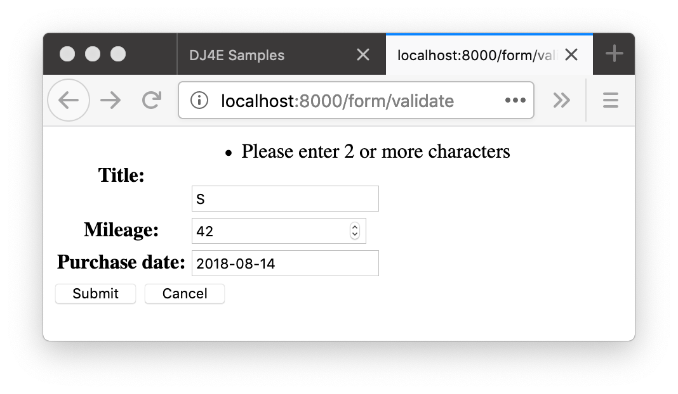
Form Data Errors
https://samples.dj4e.com/form/validate
Sometimes there are validation rules when you are filling out a form.
When you submit the form, the view code checks the data to see if there are errors
If there are errors, data is not saved and the user is notified and usually given a chance to edit and resubmit

Slide 75
Django form validation
dj4e-samples/form/forms.py
class BasicForm(forms.Form):
title = forms.CharField(validators=[
validators.MinLengthValidator(2, "Please enter 2 or more characters")
])
mileage = forms.IntegerField()
purchase_date = forms.DateField()
https://docs.djangoproject.com/en/2.1/ref/validators/

Slide 76
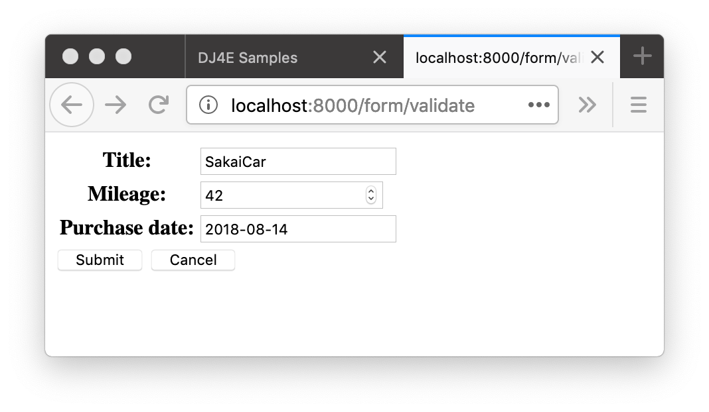
GET
class Validate(View):
def get(self, request) :
old_data = {
'title': 'SakaiCar',
'mileage' : 42,
'purchase_date': '2018-08-14'
}
form = BasicForm(initial=old_data)
ctx = {'form' : form}
return render(request, 'form/form.html', ctx)
def post(self, request) :
form = BasicForm(request.POST)
if not form.is_valid() :
ctx = {'form' : form}
return render(request, 'form/form.html', ctx)
# Save the Data
return redirect('/form/success')
def success(request) :
return HttpResponse('Thank you!')
200
dj4e-samples/form/views.py

Slide 77
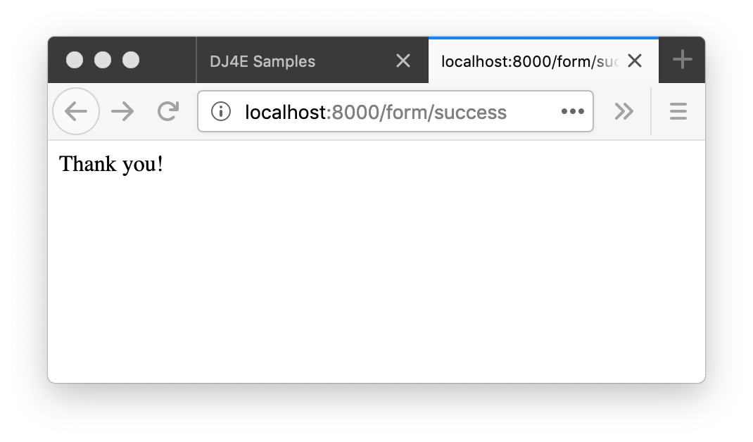
https://samples.dj4e.com/form/validate
class Validate(DumpPostView):
def get(self, request) :
old_data = {
'title': 'SakaiCar',
'mileage' : 42,
'purchase_date': '2018-08-14'
}
form = BasicForm(initial=old_data)
ctx = {'form' : form}
return render(request, 'form/form.html', ctx)
def post(self, request) :
form = BasicForm(request.POST)
if not form.is_valid() :
ctx = {'form' : form}
return render(request, 'form/form.html', ctx)
# If there are no errors, we would save the data return redirect('/form/success')
def success(request) :
return HttpResponse('Thank you!')
POST
302
200
GET

Slide 78
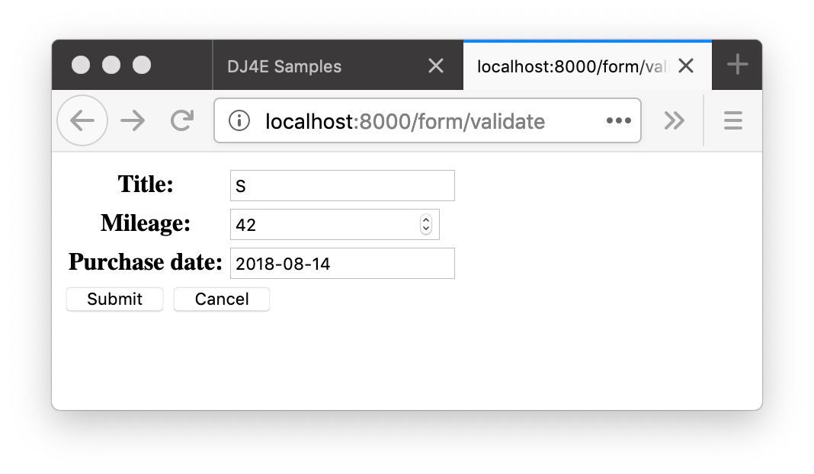
class Validate(DumpPostView):
def get(self, request) :
old_data = {
'title': 'SakaiCar',
'mileage' : 42,
'purchase_date': '2018-08-14'
}
form = BasicForm(initial=old_data)
ctx = {'form' : form}
return render(request, 'form/form.html', ctx)
def post(self, request) :
form = BasicForm(request.POST)
if not form.is_valid() :
ctx = {'form' : form}
return render(request, 'form/form.html', ctx)
# If there are no errors, we would save the data
return redirect('/form/success')
def success(request) :
return HttpResponse('Thank you!')
POST
200

Slide 79
Summary
HTML for Forms
GET versus POST
POST Redirect GET
CSRF
Django forms
Form Validation
We will learn more features of Django form objects

Slide 80
Acknowledgements / Contributions
These slides are Copyright 2019- Charles R. Severance (www.dr-chuck.com) as part of www.dj4e.com and made available under a Creative Commons Attribution 4.0 License. Please maintain this last slide in all copies of the document to comply with the attribution requirements of the license. If you make a change, feel free to add your name and organization to the list of contributors on this page as you republish the materials.
Initial Development: Charles Severance, University of Michigan School of Information
Insert new Contributors and Translators here including names and dates
Continue new Contributors and Translators here

Slide 81
Additional Source Information
Portions of the text of these slides is adapted from the text www.djangoproject.org web site. Those slides which use text from that site have a reference to the original text on that site. Django is licensed under the three-clause BSD license.

